Slide 1
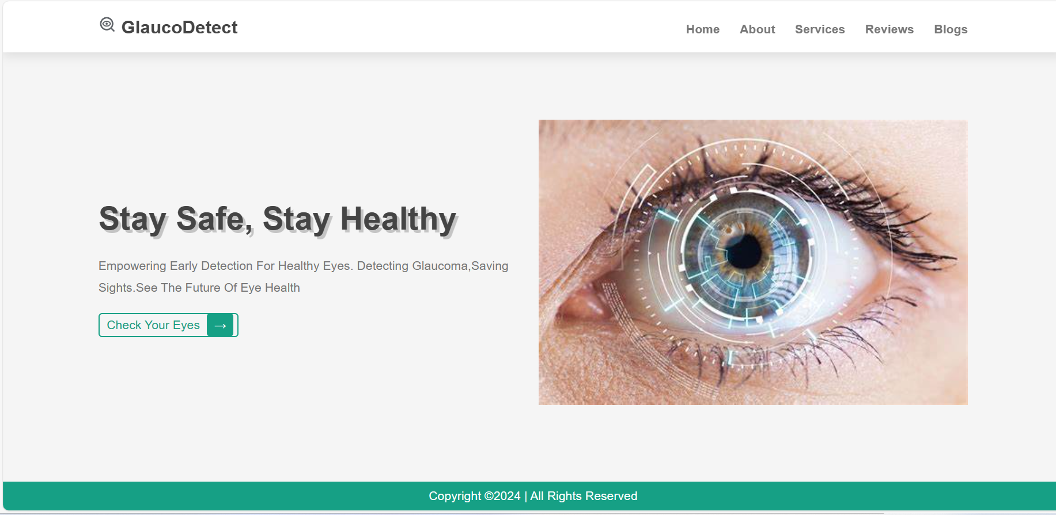

Slide 2
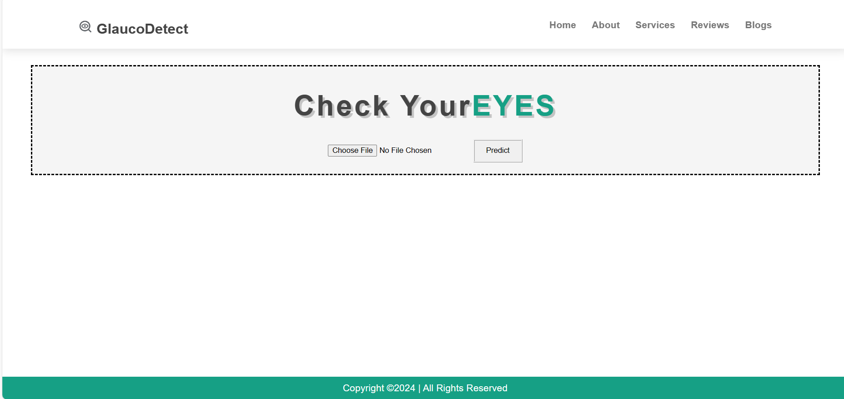

Slide 3
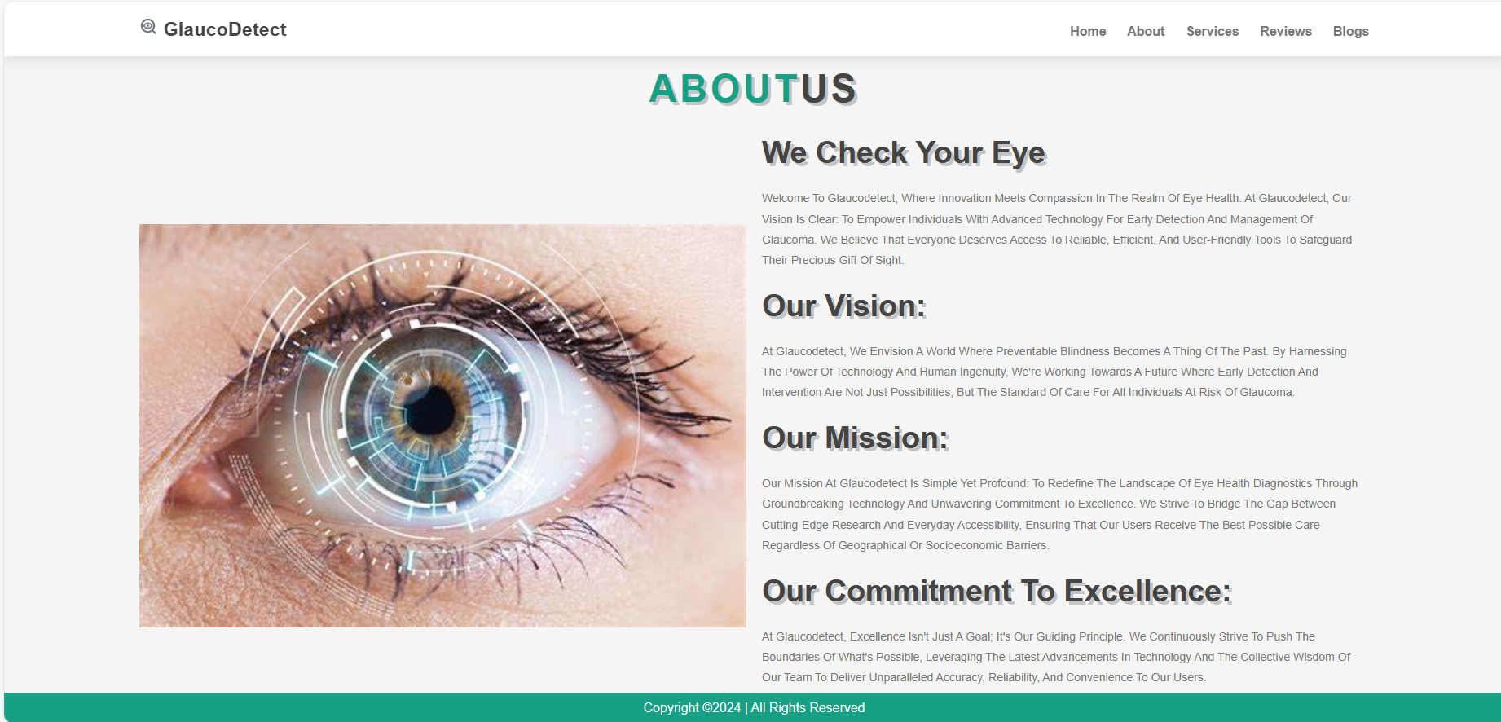

Slide 4
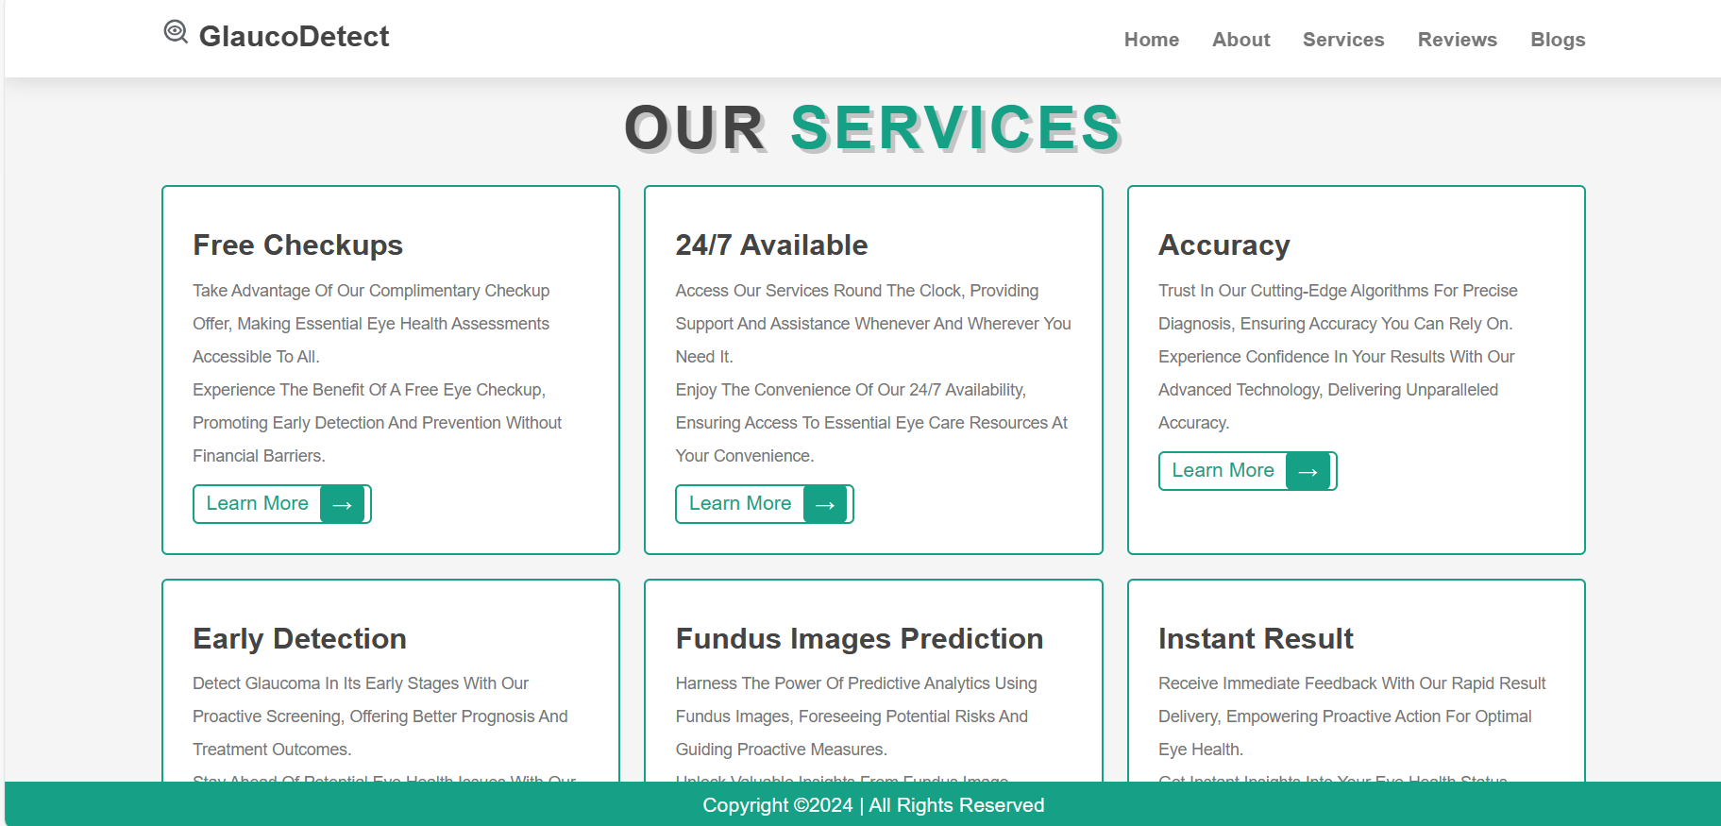

Slide 5
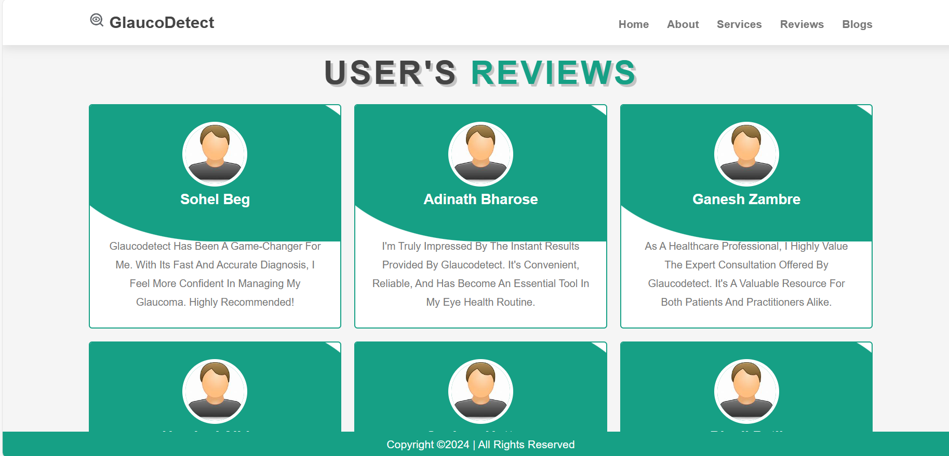

Slide 7
Import Libraries/Dataset
Routing
/predict
Data preprocessing/Augmentation
Choose File
Prediction
Predict
Data
Normalization/Rescaling
Processing
(Image Path)
Frontend
Generators
Load Model
Model Implementation
Convolutional Neural Networks
FLASK-Backend
Model Training
Fine Tunning
Final Model
(model.save)
Glaucoma Detection [CNN] Model

Slide 8
Use case view
User
Upload Fundus Image
Preprocess Image
Apply CNN Algorithm
Prediction
Detect Glaucoma +ve/-ve
Display Result

Slide 9
Activity Diagram / Flowchart
Apply CNN Algorithm
Prediction
Result Analysis
Preprocess Image
Glaucoma Positive
Start
Upload Fundus Image
Glaucoma Negative
Display Result
End

